Slide 1
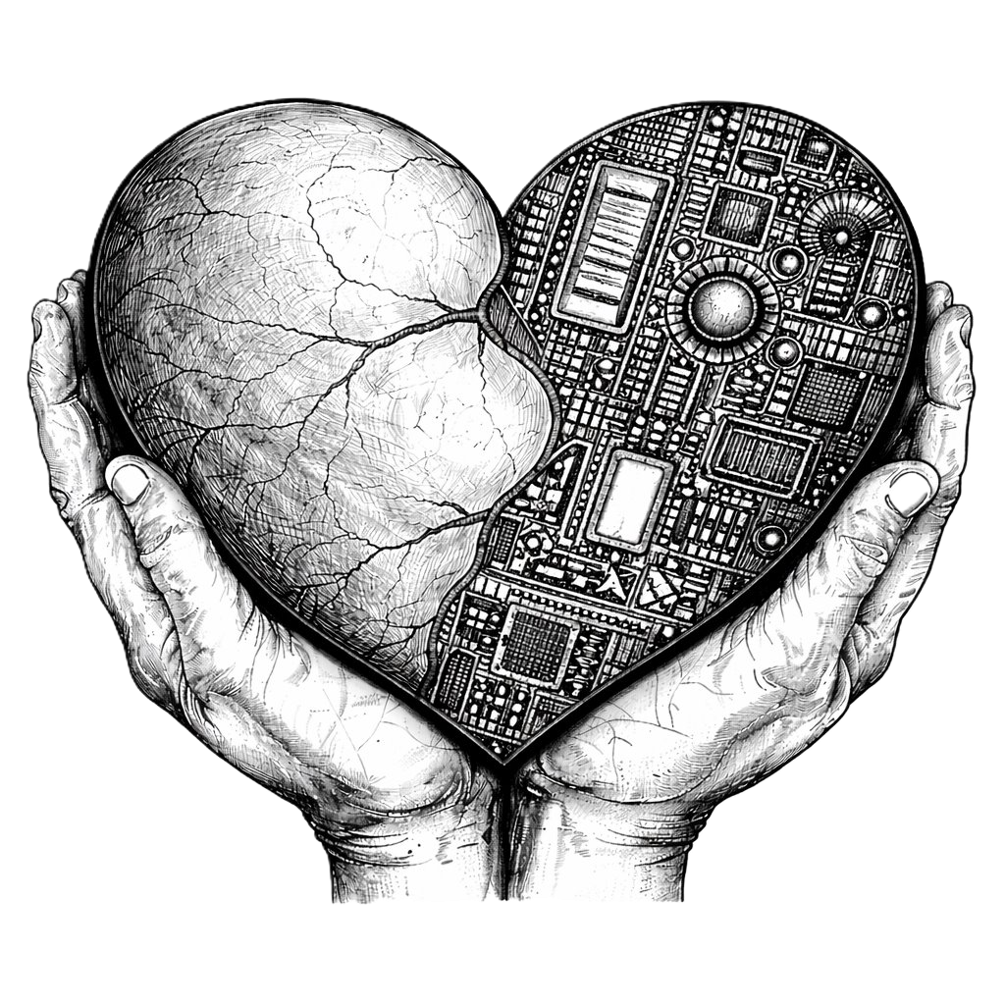
Goal: Good Health and Well-being
PROJECT DONE BY: K. Devi Gangotri S. Akshara Samhitha A. Anitha Grace T. Enosh

Slide 2

Why Good Health and Well-being is Important
Good health helps people live longer and happier lives.
Preventing diseases is easier than treating them.
Technology can help people manage their health better.
Health monitoring systems improve exercise safety and treatment management.
These systems support doctors and patients in managing medical care.

Slide 3
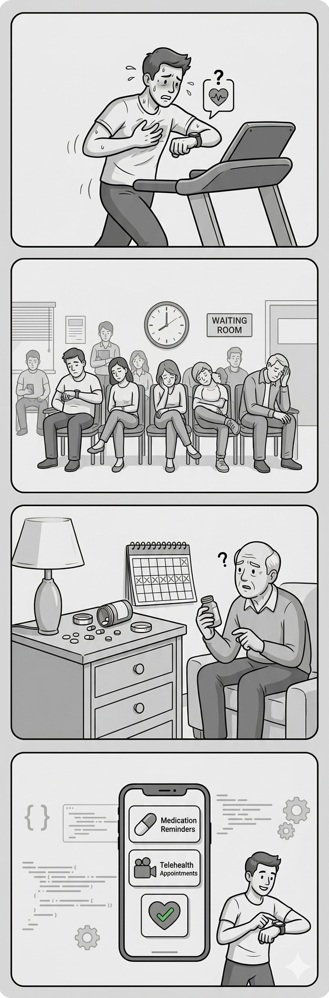
Overview
Many people face health management problems, such as:
Exercising without knowing safe heart rate limits
Long waiting times in hospitals
Forgetting to take medicines on time
Our projects provide simple digital solutions to these problems using programming concepts.

Slide 4
Three Projects Supporting Good Health and Well-being
Heart Rate Zone Calculator
Helps people exercise within a safe heart rate range.
Medical Appointment Scheduler
Uses queue data structures to manage patient flow.
Pill Reminder System
Sends notifications to remind users to take medicine on time.

Slide 5
Heart Rate Zone Calculator
Introduction
A Heart Rate Zone Calculator helps determine the safe heart rate range during exercise based on a person's age.
Applications
Fitness training
Gym workouts
Cardio exercises
Personal health monitoring

Slide 6
How the Program Works
The user enters their age.
The program calculates Maximum Heart Rate.
It then determines different heart rate zones, such as:
Warm-up zone
Fat-burn zone
Cardio zone
Peak zone

Slide 7
Conclusion
Drawbacks
Does not consider medical conditions.
Requires accurate user input.
Provides only a basic estimation
This program helps users understand safe heart rate levels, promoting healthy workout habits.

Slide 8
Medical Appointment Scheduler
Introduction
The Medical Appointment Scheduler simulates a doctor’s clinic system using a Queue Data Structure.
Applications
Hospitals
Clinics
Diagnostic centres
Online appointment systems

Slide 9
How the Program Works
Patients are added to a queue when they arrive.
The system follows the FIFO Principle (First In, First Out).
The program can:
Add new patients
Display waiting list
Remove patients after consultation

Slide 10
Conclusion
Drawbacks
Cannot automatically detect emergency cases.
Requires manual data entry.
Only a simulation of real hospital systems.
This system helps improve clinic organization and patient flow management.

Slide 11
Pill Reminder System
Introduction
The Pill Reminder System reminds users to take medication at scheduled times.
Applications
Daily medication patients
Elderly care
Long-term treatments
Home healthcare systems

Slide 12
How the Program Works
The user sets medicine schedule times.
The program continuously checks the system clock.
When the scheduled time arrives:
A desktop notification appears
The user gets a reminder alert

Slide 13
Conclusion
Drawbacks
Requires the computer to stay ON.
Notifications may be missed if the user is away.
Needs correct system time.
This program improves medicine adherence and supports better treatment outcomes.

Slide 14
Project screenshots
Heart Rate Zone Calculator
Medical Appointment Scheduler
Pill Reminder System

Slide 15
Overall Impact
Technology can significantly improve health and well-being.
These projects show how programming can help with:
Safe exercise monitoring
Efficient hospital management
Medication reminders
Key Message
Simple health programs can make exercise, medical care, and medication management easier and safer.

Slide 16
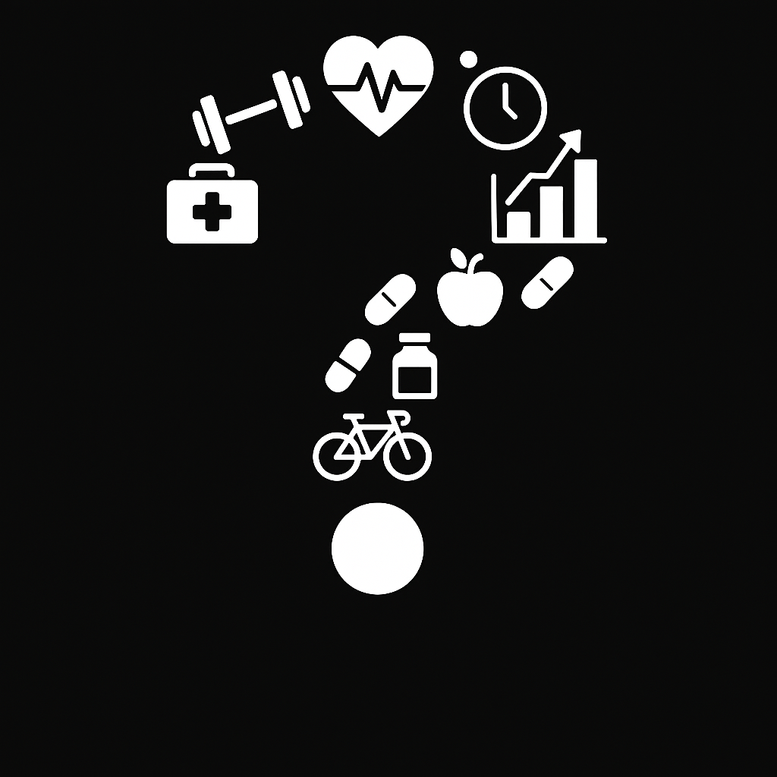
Queries
Any Questions?
Thank you for your attention.
We would be happy to answer any questions.

Slide 17


